Slide 1
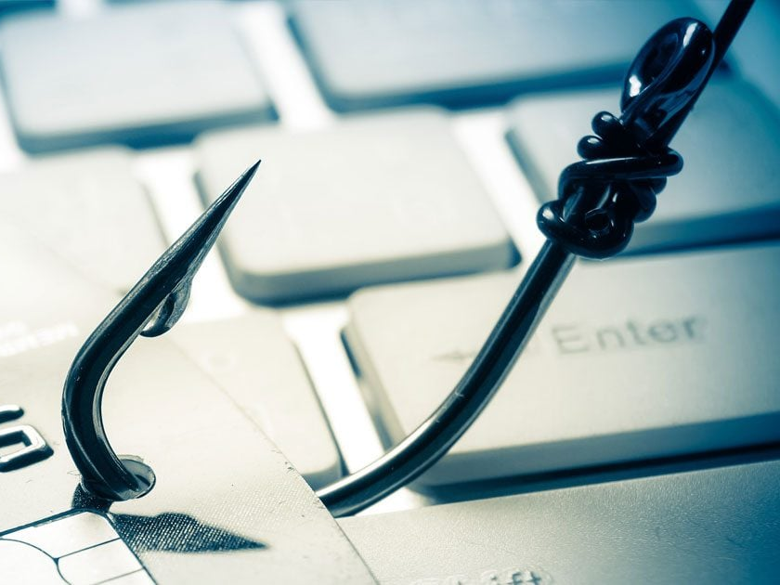
Phishing and Social Engineering Awareness
Understanding and Preventing Social Engineering Attacks
Presented By: Arr Domingo
Notes:
Hello everyone, my name is Arr Domingo, your cybersecurity trainer, and today I’ll be talking about Phishing and Social Engineering Awareness.
These attacks are becoming more sophisticated every day, and understanding how they work is key to protecting ourselves and our organization."

Slide 2
Agenda
Definition of Social Engineering and Phishing
Why This is a Risk to Wayne Enterprise
Realistic Examples
Consequences of Falling Victim
Best Practices and Mitigations
Notes:
*"Here’s what we’ll cover in the next few minutes:
First, we’ll define social engineering and phishing.
Then, we’ll look at why this is a risk for Wayne Enterprise.
I’ll share some realistic examples of these attacks.
We’ll discuss the consequences of falling victim.
Finally, I’ll go over best practices and mitigations."*

Slide 3

Topic Overview
Social Engineering: Manipulating individuals to gain confidential information.
Phishing: Fraudulent emails to steal credentials.
Vishing: Voice phishing via phone calls.
Smishing: SMS-based phishing attacks.
Notes:
Slide 3: Topic Overview
"Social engineering is all about manipulating people to give up confidential information.
Phishing is one of the most common forms—fraudulent emails designed to steal credentials.
There’s also vishing, which uses phone calls,
and smishing, which uses SMS messages.
Attackers exploit trust and urgency to trick victims."

Slide 4




Organizational Context
Wayne Enterprise employees are prime targets for attackers.
Phishing emails can compromise sensitive corporate data.
Phone scams (vishing) may trick employees into revealing passwords.
SMS scams (smishing) can install malware on devices.
Notes:
Slide 4: Organizational Context
"Why is this important for Wayne Enterprise? Because our employees are prime targets.
Phishing emails can compromise sensitive corporate data.
Phone scams might trick someone into revealing passwords.
And SMS scams can install malware on devices. One mistake can lead to serious consequences."

Slide 5



Realistic Examples
Example 1: Email claiming to be from IT asking for login credentials.
Example 2: Phone call pretending to be from HR requesting confidential info.
Example 3: SMS with a link to 'update your account' leading to fake site.
Notes:
Slide 5: Realistic Examples
*"Let’s look at a few examples:
An email claiming to be from IT asking for your login credentials.
A phone call pretending to be HR requesting confidential info.
An SMS with a link to ‘update your account,’ which actually leads to a fake site.
These attacks look convincing, and that’s why awareness is critical."*

Slide 6




Consequences of Falling Victim
Data breaches leading to financial loss.
Reputational damage to Wayne Enterprise.
Legal and compliance penalties.
Loss of customer trust.
Notes:
Slide 6: Consequences
*"What happens if we fall victim?
Data breaches can lead to financial loss.
Our company’s reputation can suffer.
There may be legal and compliance penalties.
And most importantly, we lose customer trust.
These are risks we cannot afford."*

Slide 7

Best Practices and Mitigations
Verify sender identity before clicking links or sharing info.
Do not share passwords over email or phone.
Report suspicious emails and calls to IT immediately.
Enable Multi-Factor Authentication (MFA) wherever possible.
Notes:
Slide 7: Best Practices
*"So, what can we do?
Always verify the sender before clicking links or sharing information.
Never share passwords over email or phone.
Report suspicious emails and calls to IT immediately.
And enable Multi-Factor Authentication wherever possible.
These simple steps make a big difference."*

Slide 8

Key Takeaways
1
2
3
4
Think before you click: Always verify.
Never share credentials via email, phone, or SMS.
Report suspicious activity promptly.
Stay informed and vigilant against social engineering tactics.
Notes:
Slide 8: Key Takeaways
*"To wrap up:
Think before you click—always verify.
Never share credentials via email, phone, or SMS.
Report suspicious activity promptly.
Stay informed and vigilant.
Together, we can protect ourselves and Wayne Enterprise from these threats."*

